Slide 1
Market price prediction
Momelezi dlavu

Slide 2
Today’s agenda
Objective
Process
Insights
Results
Summary

Slide 3

Objective
This project aims to develop a robust time series machine learning model capable of accurately forecasting market trends based on historical data. By leveraging advanced algorithms, we aim to predict the quantity and prices of commodities for future months, empowering stakeholders to make proactive decisions regarding production, procurement, pricing strategies, and resource allocation.

Slide 4
Process
Data Understanding and Preprocessing
Exploratory Data Analysis (EDA)
Feature Engineering
Model Development
Model Evaluation
Fine-tuning and Validation

Slide 5
insights

Slide 9
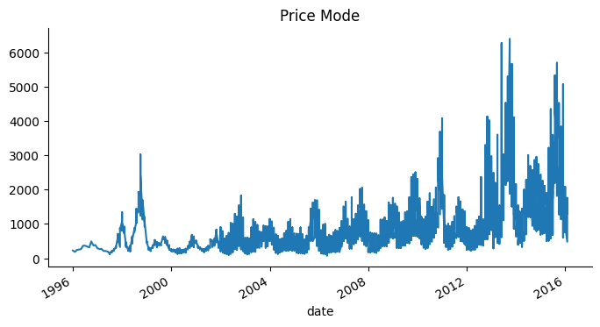

Slide 10
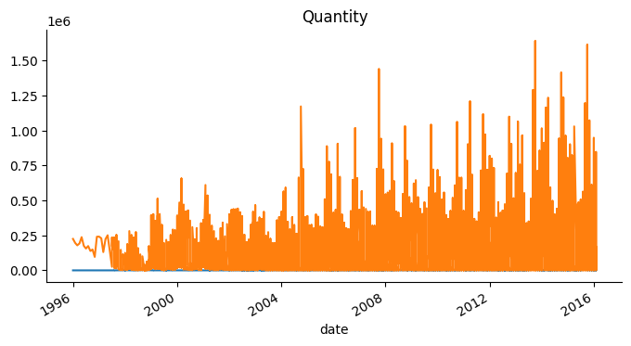

Slide 11
Results for price mode
Model | MAE | MSE | RMSE
ARIMA | 425.68 | 281013.9 | 530.11
Prophet | 906.54 | 959086.72 | 979.33
LSTM | 871.48 | 910978.94 | 954.45

Slide 12
Results for quantity
Model | MAE | MSE | RMSE
ARIMA | 60765 | 5618379564 | 74955
Prophet | 150045 | 25872612600 | 160849
LSTM | 83175 | 12574158892 | 112134

Slide 13
results
Model | p | d | q | MAE | MSE | RMSE
ARIMA | 5 | 1 | 1 | 394 | 251990 | 501
Price Mode Best ARIMA Model: ARIMA(5, 1, 1)
Quantity Best ARIMA Model: ARIMA(2, 1, 1)
Model | p | d | q | MAE | MSE | RMSE
ARIMA | 2 | 1 | 1 | 59490 | 4148910978 | 64412

Slide 14

Thank you!!!
Any questions?

